Slide 1
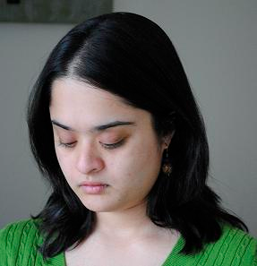


Roles of Appearance and Contextual Information
Devi Parikh, Larry Zitnick and Tsuhan Chen

Slide 2
When?
High intra-class variance
Chairs
Low inter-class variance
Lemon vs. tennis ball
Occlusion
Low resolution image
Image of a far away scene
Bad quality
[Bustos et.al., CSUR 2005]
[Rabinovich et al., ICCV 07]

Slide 3
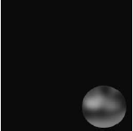
Popular motivations for context…
[Antonio Torralba]

Slide 4
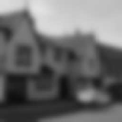
Popular motivations for context…
[Antonio Torralba]

Slide 5
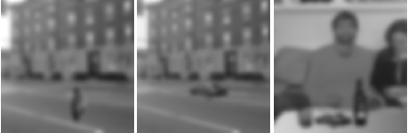
Popular motivations for context…
[Antonio Torralba]

Slide 6
Popular motivations for context…
[Antonio Torralba]

Slide 7
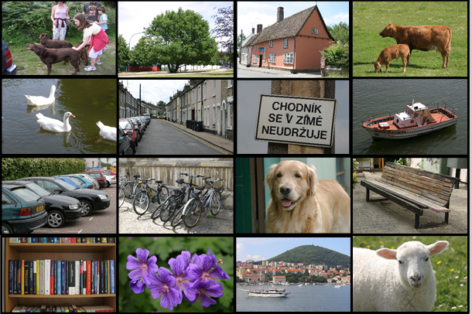
However…
Let’s look at it more carefully…

Slide 8




Object appearance

Slide 9
Appearance + Context

Slide 10
Blind recognition

Slide 11
Low resolution

Slide 12
High resolution

Slide 13
Blind recognition

Slide 14
Appearance + Context

Slide 15
When?
Humans?
Machines?

Slide 16
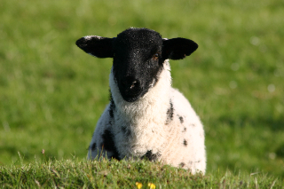

Set-up
?
?
?
?
?
Low Resolution
Appearance
Machine
High Resolution
Context
Human

Slide 17
Low resolution: Appearance

Slide 18
Low resolution: Context

Slide 19
Low resolution: Appearance + Context

Slide 20
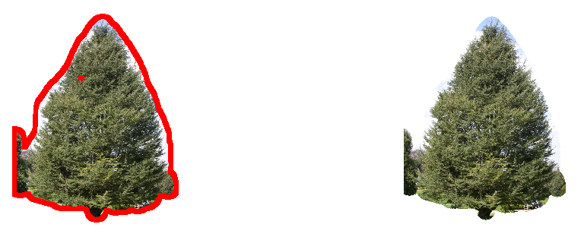
High resolution: Appearance

Slide 21
High resolution: Context

Slide 22
High resolution: Appearance + Context
11 subjects
2 sessions
3 scenarios
70 segments

Slide 23
Related work
[Torralba et al., Tech Report 2007]

Slide 24
Machines
?
?
?
?
?
Inference:
Belief Propagation
Appearance
Context
Texture + Shape
[TextonBoost]*
Color
[GMM]
Co-occurrence**
Relative location
Relative scale
Neural Network
*[Shotton et al., ECCV 2006]
**[Rabinovich et al., ICCV 2007]

Slide 25
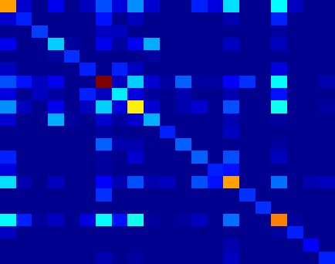
Machines
Co-occurrence**
Relative location
Relative scale
**[Rabinovich 2007]

Slide 26
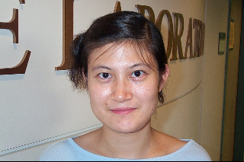
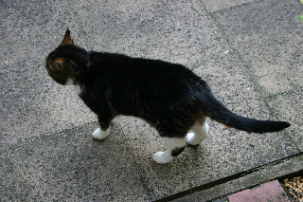


Machines
MSRC dataset
Corel dataset
[Felzenshwalb and Huttenlocher IJCV 2004]

Slide 27
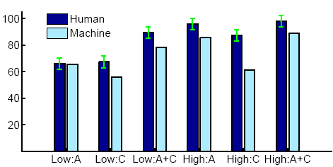
Results

Slide 28
Results
Low
High
High resolution images do not benefit from context
A: Appearance alone
C: Context alone
A+C: Appearance and context

Slide 29
Results
Low
High
Low resolution images NEED context
A: Appearance alone
C: Context alone
A+C: Appearance and context

Slide 30
Results

Slide 31
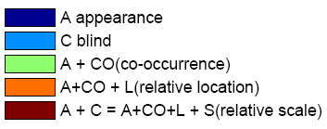
Results (Machine)
Context & Appearance help each other

Slide 32
Results (Machine)
Appearance hurts

Slide 33
Results (Machine)
Context very weak

Slide 34
Results (Machine)
Context makes no difference

Slide 35
Results (Machine)

Slide 36
Results (Machine)
Co-occurrence
Relative Location
Relative Scale

Slide 37
Results (Machine)
Failure cases

Slide 38
Results (Machine)
 | MSRC | Corel
Existing (high) | 75 ¹ | 81 ²
Proposed (high) | 91 | 93
Proposed (low) | 83 | 86
¹ [Yang et al., CVPR 2007]
² [He et al., ECCV 2006]

Slide 39
Results (Machine)

Slide 40
Contributions
Context is most useful when appearance information is weak
Low resolution images are an appropriate venue for studying context

Slide 41
Discussion
Improve appearance or context models to achieve human performance?
Need to improve both appearance and context models
In low resolution images, appearance information is similar for humans and machines
Hence, appropriate venue for studying context
Achieving human performances need not be the ultimate goal
Need to improve appearance models
Need to improve context models

Slide 42
Follow up work (PAMI 2011)

Slide 43
Results
Machine do not leverage contextual information as effectively as humans
Low
High
A: Appearance alone
C: Context alone
A+C: Appearance and context
Are machine missing a source of context?

Slide 44
Different Sources of Context

Slide 45

Different Sources of Context: None

Slide 46
Different Sources of Context: Cooc

Slide 47
Different Sources of Context: Rel-scale

Slide 48
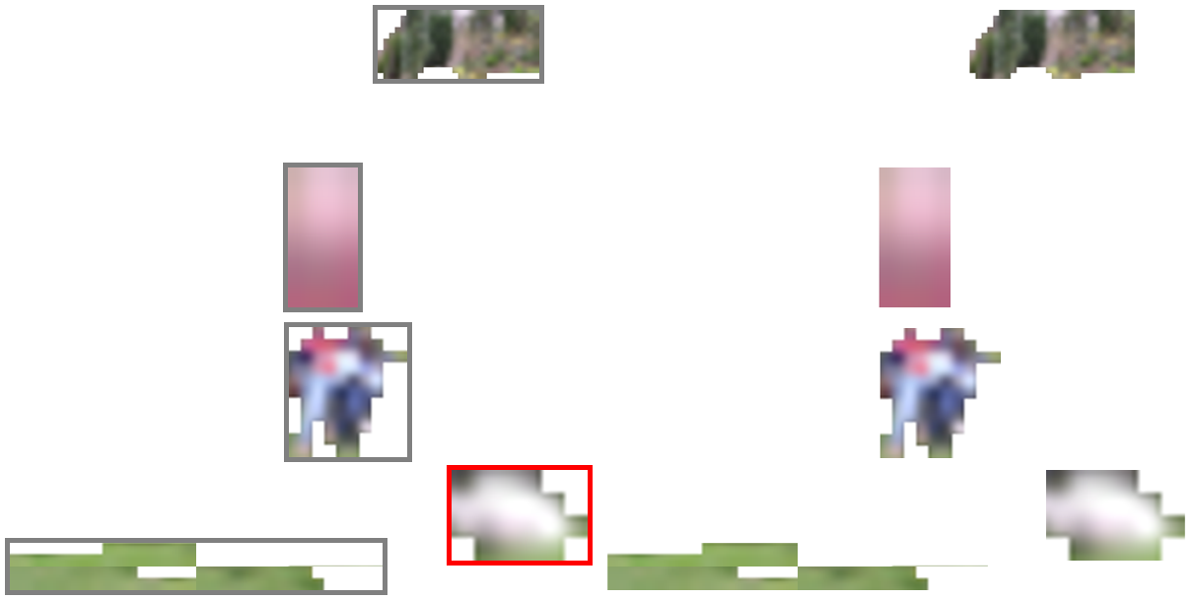
Different Sources of Context: Rel-loc

Slide 49
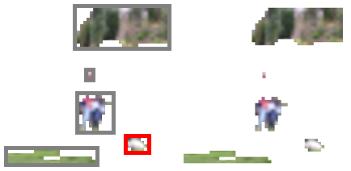
Different Sources of Context: All

Slide 50

Different Sources of Context: All

Slide 51

Different Sources of Context: Blind

Slide 52

Different Sources of Context: Image

Slide 53

High Resolution Appearance

Slide 54
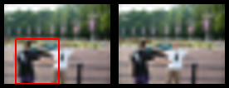

PASCAL
“Natural” scenes
Bounding boxes
Common pixels
More void

Slide 55
Results

Slide 56
Results
Co-occurrence information helps in both datasets.
Relative location does not help in PASCAL.

Slide 57

MSRC Location Statistics
Building
Grass
Tree
Cow
Sheep
Sky
Aeroplane
Water
Face
Car
Bicylce
Flower
Sign
Bird
Book
Chair
Road
Cat
Dog
Body
Boat

Slide 58

PASCAL Location Statistics
Aeroplane
Bicycle
Bird
Boat
Bottle
Bus
Car
Cat
Chair
Cow
Dining table
Dog
Horse
Motorbike
Person
Potted plant
Sheep
Sofa
Train
TV / monitor

Slide 59
Results
Relative scale information does not help across the board.
Notes:
Relative scale information does not help across the board.

Slide 60
Results
Relative scale information does not help across the board.

Slide 61
Results
Our choice of visualization does not affect performance in MSRC.

Slide 62
Results
There is information in the “void” (unlabeled) pixels!
We leverage this cue for object detection
Congcong Li, Devi Parikh and Tsuhan Chen.
Extracting Adaptive Contextual Cues from Unlabeled Regions, ICCV 2011

Slide 63
MUCH more interesting analysis and findings in the PAMI 2011 paper:
Exploring Tiny Images: The Roles of Appearance and Contextual Information for Machine and Human Object Recognition

